Slide 1

LatentView Analytics Enabling business impact through AI & ML
June 18, 2019

Slide 2
Agenda
1
Introduction to LatentView
2
Enabling business impact through AI & ML
3
Customer Success Stories

Slide 3
Introduction to LatentView

Slide 4


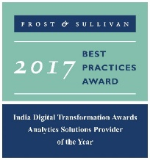




LatentView – A World Class Analytics Company
Awards & Recognition
Founded in
Over
Grown
Work with
600
11
30+
2006
Strong Performer - Customer Analytics Services, 2017
People strong
times in last
six years
Fortune 500
firms
Repeat business at
Member of
Rated as Top
2009-2017
Technology council
10
5%
4/5
>85%
Repeat
business
Analytics companies to work for in India
Re-investment in Research and Development
Top technology companies engage with us

Slide 5
The LatentView Approach
We empower customers in their digital transformation journey by helping them move up the analytics maturity curve through actionable insights that leads to
data-driven decisions
MATH
ACTIONABLE
DATA
INSIGHTS
BUSINESS
TECH

Slide 6


























Trusted analytics partner to the world’s most recognized brands

Slide 7
Enabling Business Impact through AI & ML

Slide 8
The LatentView Approach
Getting the data together
Making sense of the data
AI & ML to drive business impact
Data Acquisition
Acquiring & consolidating the disparate data sources.
Data Engineering
Integrating various forms of data into centralized data lake using on-premise & cloud based technologies
Data Processing
Process various forms of disparate data – Structured, Unstructured, Physical, Human Interactions, Machine Generated, Real Time etc
Graph Analysis
Exploration of frequency, strength and direction of relationships & Causalities.
Exploratory Analysis
Deep insights from all forms of data using traditional methods (Segmentation & Clustering)
Natural Language Processing
Analyze dimensional insights & relationships by automated tagging
Real Time Analytics
Experience in sub-second big data processing for real time applications
Deep Learning & AI
Self governing systems leveraging AI & eliminating manual intervention
Machine Learning
Deep experience with various machine learning algorithms, including Ensemble Learning, Neural Networks, etc.

Slide 9









1. Getting the data together
How to acquire data?
How to create a unified data view?
How to enable consumption?
Structured Data
External / Internal
Customer Data
Web Data
Data Integration
METRIC & EXCEPTION
REPORTS
Marketing Data
Structured
Payment Data
Data store pipelines enables metric & exception reporting
App Data
INTERACTIVE VISUALIZATON
Data Lake
Dispute Information
API endpoints enabling integration with
other systems
OPERATIONAL
Unstructured Data
External / Internal
Voice Data
Unstructured
ML / AI Workbench for
Prediction & Insights
Chat Data
ADVANCED
ANALYTICS
Email Data
Biometric Data
Social Data
Other data sources

Slide 10
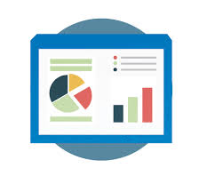


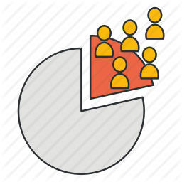

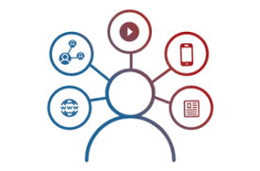


2. Making sense of the data
Reporting & Visualization
Performance Management, KPI Measurements
Monitoring & Control
Real Time Assurance, Audit & Compliance
Voice of Customer
Criticalities, Competitive Intelligence
Segmentation & Clustering
Personalization, Appropriateness etc.
Relationship & Causalities
Implementation, Strategy &
Prioritization
Digital Analytics
Consumer Journeys, Marketing Effectiveness
Experimentation
Experimentation at scale, A/B testing etc.
Integrated & Disparate sources in Data Lake

Slide 11


3. AI / ML to drive business impact
Business Planning
Demand Prediction
Market Strategy
Strategic Investments
Early Warning Alerts
Customer Complaints
Transactional Risks
Loss Prevention
Innovation / Insights
Voice of Consumer
Competitive Intelligence
Product Governance
Customer Engagement
Personalization
Acquisition & Conversion
Customer Experiences
Self Serve Analytics through Micro Applications
Complex Data Linearly Scalable With Data Volume
Faster Time To Market Due To Less Set Up Time
Artificial Intelligence / Machine Learning
Integrated & Disparate sources in Data Lake

Slide 12
Engagements in AI, ML, DL
ARTIFICIAL INTELLIGENCE
Automate business decision making in a complex environment with random effects, multiple agents and non-linear interactions
Amplifyr
AI driven Platform
Chatbot- Innovation Radar Assistant (IRA)
SNAP – A Voice based analysis platform
MACHINE LEARNING
AI Engagements
Derive insights from data through Mathematical & Probabilistic approaches in Machine Learning, Estimating Uncertainty, Causal Inference and Interpreting Black Box Models
Risk Identification By Modeling Customer Behavioral Patterns
Early Warning System to Enhance Customer Satisfaction
DEEP LEARNING
ML Engagements
Advanced computer perception by utilizing state of the art CNN, LSTM implementations for Text, Images, Speech & Video processing
Deep Learning Engagements
Social Insights Platform for Marketing Strategy
Early Detection Of Defective Transactions

Slide 13


































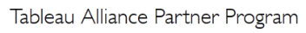
Tools, Technology & Partnerships
Data Engineering
Data Science & Modelling
Data Visualization
Tableau
Measurement Partner
Alliance Partner

Slide 14
Customer Success Stories

Slide 15



Representative Case Studies
Leading Asset Management Company in UK
Broad Line Food Distributor in U.S
Leading Snacks & Beverages Company
Leading Fashion
E-Commerce
Digital Transformation partner supporting commercial & customer excellence initiatives
Partnered with Client Services team on key projects in Revenue Management - Account Profiling, Retention Modelling, Cross Sell Campaigns etc.
Personalization & Digitization of 1:1 Marketing & Distribution across commercial client segments
Amazon based data lake integrates data from 27 OpCo & Recommendation Engine built to Accelerated Local Case Growth & Margin Improvement
Centre of Excellence (CoE) partner to the world’s leading snacks & beverages company
Partnered with commercial stakeholders on Performance management of RSR, Shipping & Client Interactions
Performance control tower for leadership encompassing KPIs in Supply Chain, Business Performance, Customer & Platform Experience
Developed Supply Chain Demand Forecasts & Inventory Movement Intelligence for the demand planning team

Slide 16
Leading Asset Management Company in UK

Slide 17





Digital Transformation of Client Services
Leading Financial Services firm in UK operating in 50 Countries
1
Digital transformation & Data driven strategy for Client Services
Create personal connection with customers to,
Customer Profiling
Engagement Score
Reduce retention rates & Disinvestments
Drive product diversification (Cross sell)
Achieve Marketing efficiency at scale
Solution: Consultative Recommendation & Implementation
2
3
4
Assessed Analytics/Data maturity, Technology landscape & Execution feasibility
Marketing KPI & Effectiveness
Early Warning of Disinvestment
Recommendation for Cross Sell
Recommended, developed & implemented following 4 Analytics streams

Slide 18
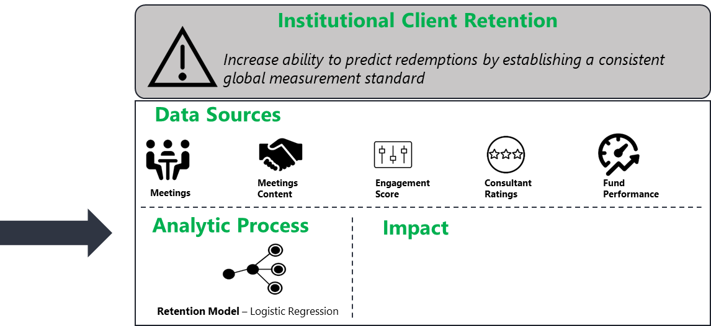
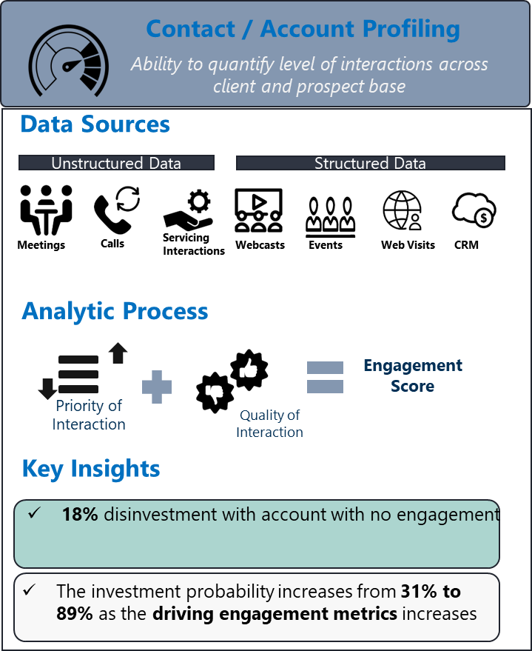
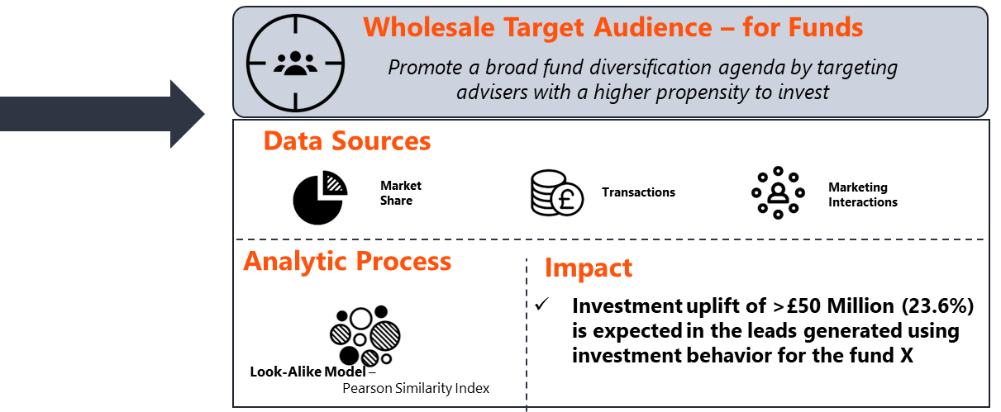
Digital Transformation of Client Services
Retention Model captures 40% more disinvestments than the current risk evaluation

Slide 19
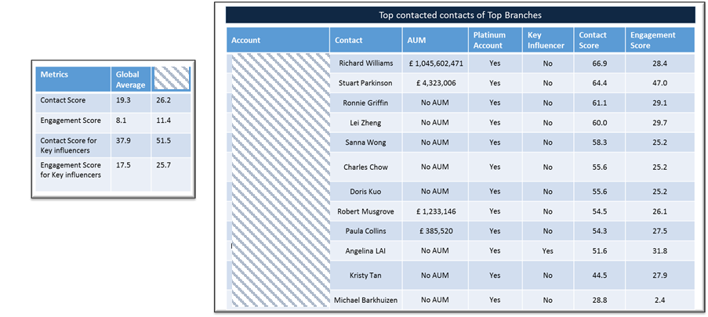
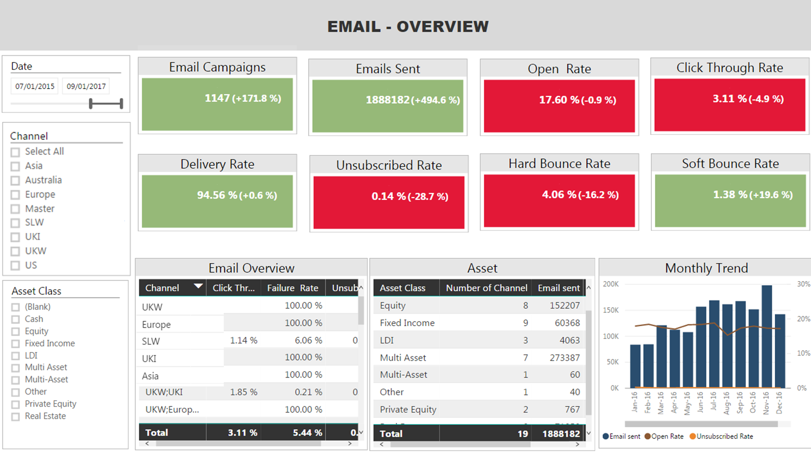
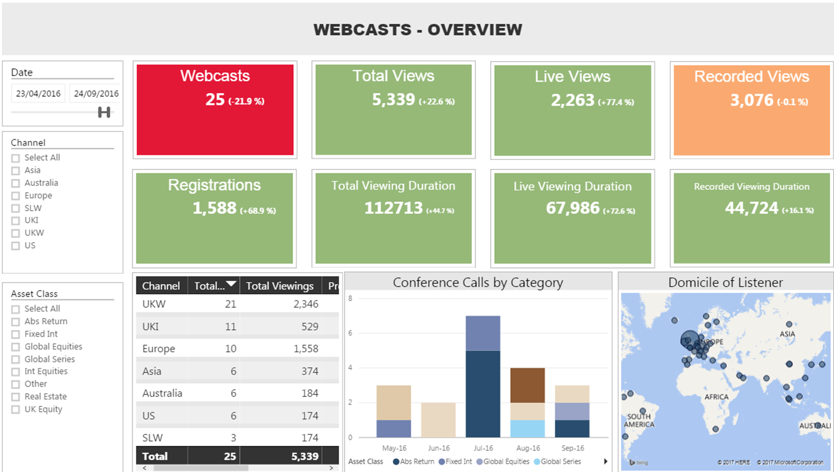
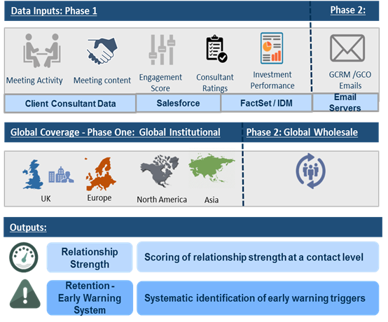
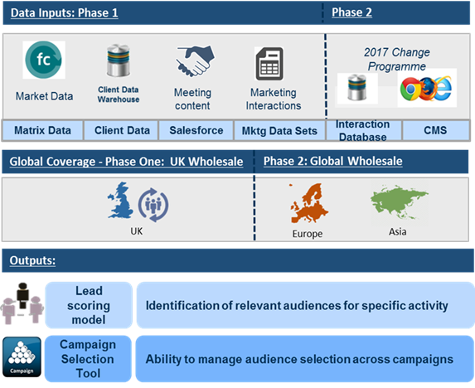
Digital Transformation of Client Services
1
2
3
4
←

Slide 20
Broadline Food Distributor in U.S

Slide 21
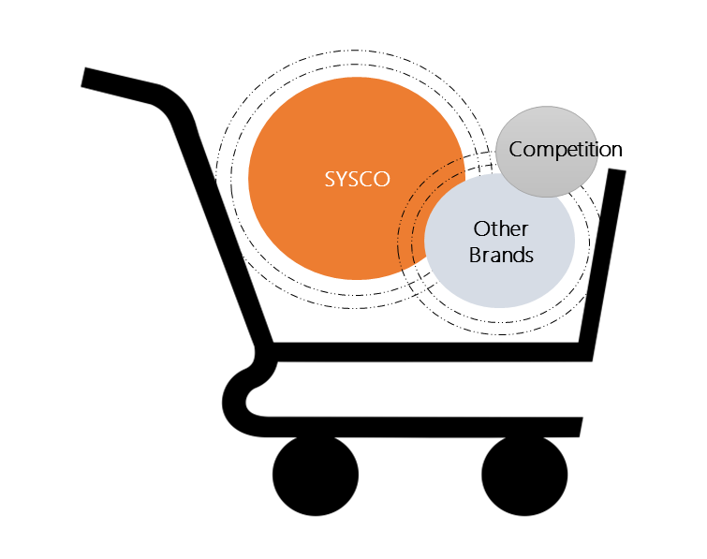
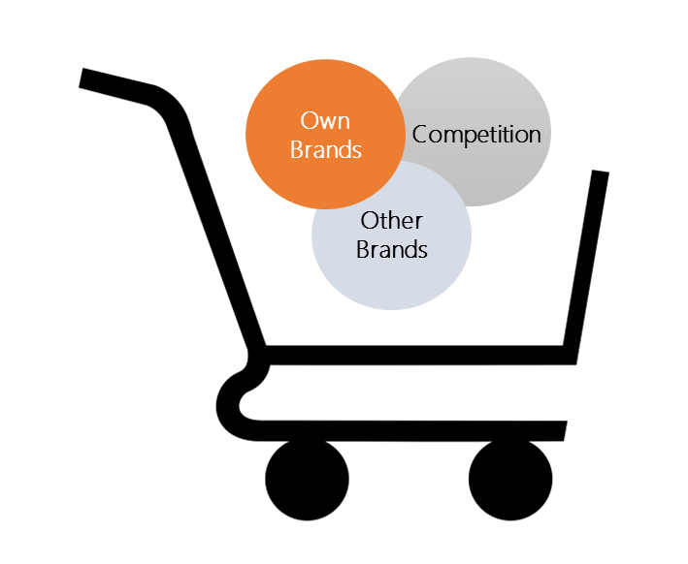
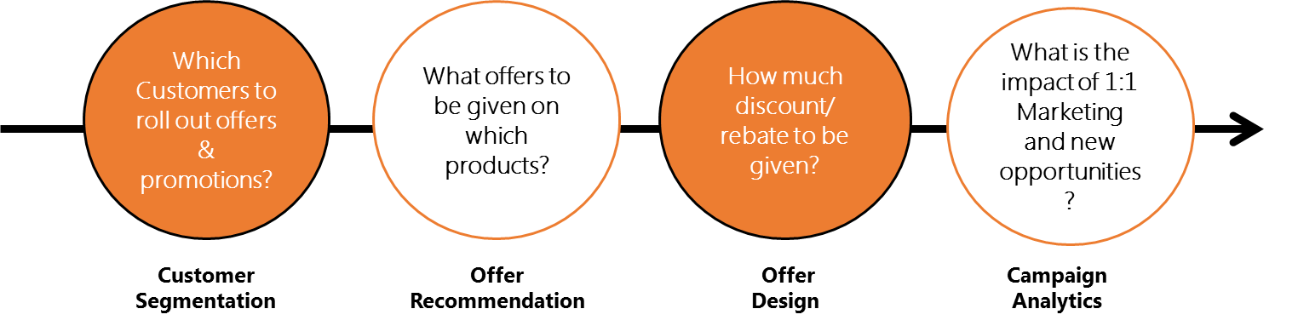
Recommendation Engine for Cross Sell & Up Sell
Largest Broad Line Food distributor in US with $23 Bn Annual Revenue
Personalization & Digitalization of Customer Services
Accelerated Local Case Growth & Margin Improvement by,
Increase Share of wallet & Volume of customer
Increase % Share of Own & High Margin products
Increase Customer engagement & loyalty
1: 1 Personalized
Marketing
Accelerated Local Case Growth
Impact
~16% Increase in Avg. Share of Wallet post the implementation of the model
~3% incremental in market share
~ 8 - Average increase in unique SKUs in existing customer

Slide 22







Recommendation Engine for Cross Sell & Up Sell
Customer History
Quick Service Restaurant
Economy Pizzeria
~Customer buys only Crust & Cheese
Segment
trend
Customer Demand & Opportunity
Personalized Offers & Promotions
~Segment buys crust, cheese and Meat
~Offer Opportunities in each product group
~ Upsell/Cross Sell/Rewards/Share of Wallet Offers
High Margin/ Sysco Products
Recommendation
Crust – Baker Source (Upsell)
Cheese & vegetables – Casa Solano(Cross Sell)
Meat – White Marble farms (Product Introduction)
Promotions & Offer
Baker Source 3% Discount on additional 50 after 500
Casa Solana – Buy Vegetables & Cheese at 10% Discount
Buy meat from White Marble farms & 20% Discount on Arrezio Sauces
~Products eligible for 1:1 Marketing

Slide 23





Recommendation Engine for Cross Sell & Up Sell
1. Customer Segmentation
2. Offer Recommendation
3. Offer Design
4. Campaign Analytics
Product Promotion – for Customer
Cross Sell
Offer Engine
(% calculation based on the product)
To identify clusters of customers with similar characteristics
Up Sell
Data Used
Offer Roll Out
Frequency
Incentives
Response & RoI Measurement
Customer,
Product,
Transaction,
Promotions
Share of Wallet
Promotion Calculation
(% calculation based on the overall basket)
Promotion on Additional Spend

Slide 24
Leading Fashion E-Commerce Company

Slide 25







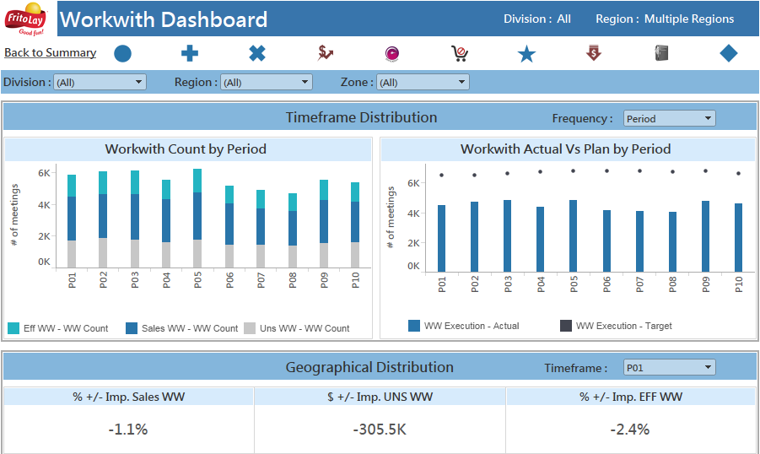

Go To Market Scorecard
Leading Snack Company
Business Objective
LatentView’s Solution
Business Benefits
To track overall business metrics and rank performance using scorecards.
To monitor the performance of Sales Representatives, the mismatches in shipping & the impact of meetings.
Automated report comprised of key business metrics ,which monitors the performance of sales representatives and the sales leaders at different levels of granularity.
Also tracks the correlation between involvement of RSR’s in Regional meetings & improvement in business metrics
LatentView solution identifies the flaws in each sector and provides the areas for improvement and determines the impact of individual metrics on business.
Sales
Efficiency
Performance of representative
Effect of metric on meeting
Shipping Audit
Levels of Granularity
Division / Region / Zone / District
Route /Customer
Order
Brands
SKU
MSSQL
Using Java to consolidate data into single source
Access DB
Distribution Leaders
HIVE

Slide 26
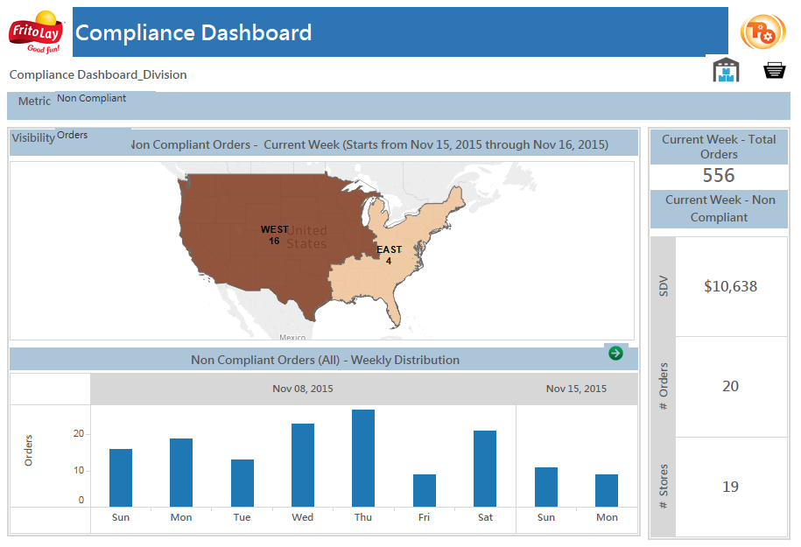
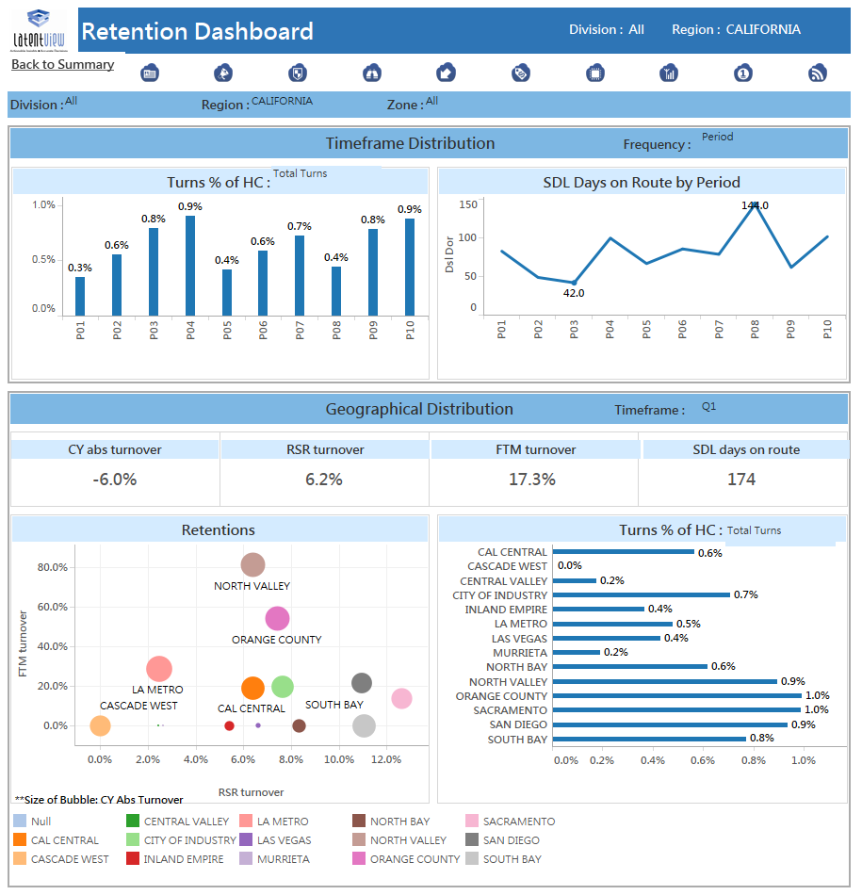
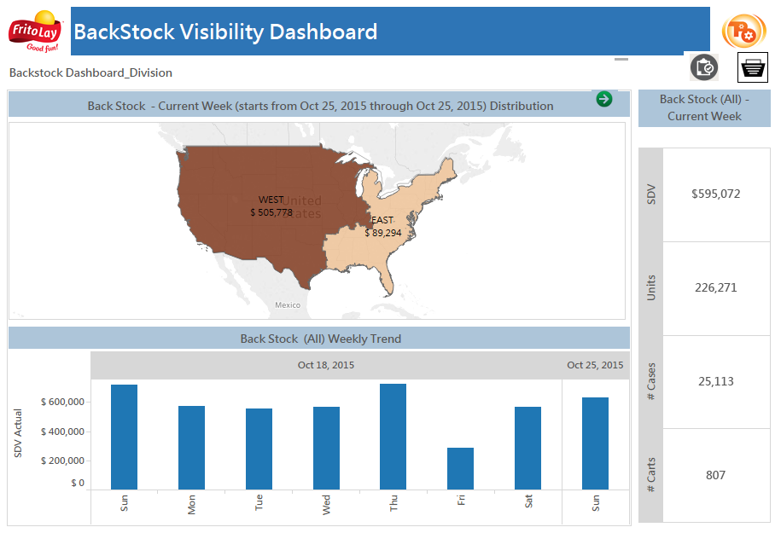
GTM Scorecard Screenshots

Slide 27
Fashion E-Commerce Company

Slide 28
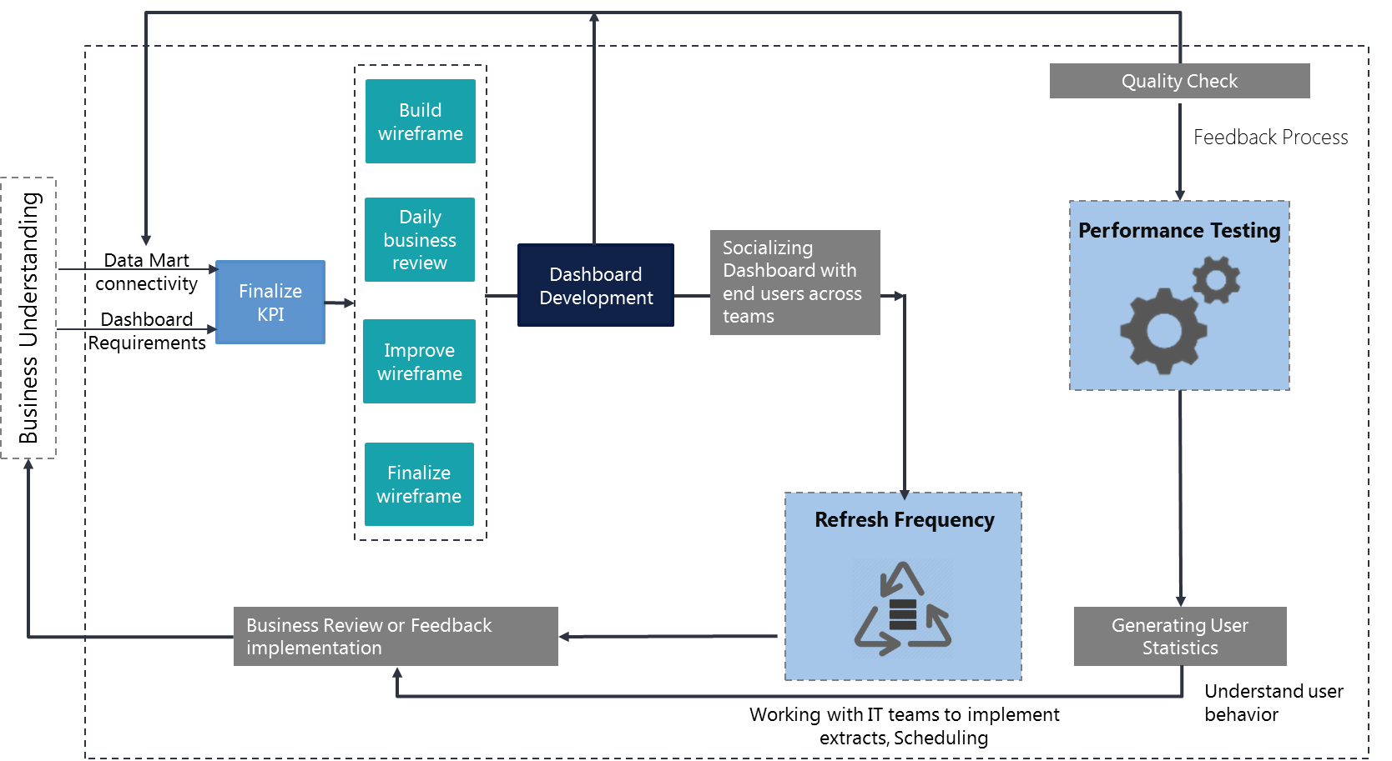
Control Tower Visualization
Client wanted to monitor key metrics in a reliable, consistent and accurate manner for the following functional areas:
Supply Chain
Customer Experience
Platform Experience
Scope of the services
Latentview proposes to build a highly scalable, available data platform on Azure with a highly responsive web application.
Framework for building the dashboards

Slide 29
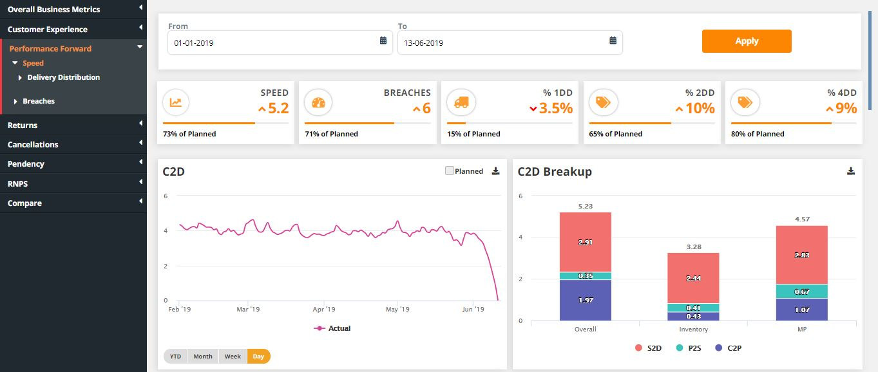
Control Tower – Measuring Performance Forward

Slide 30
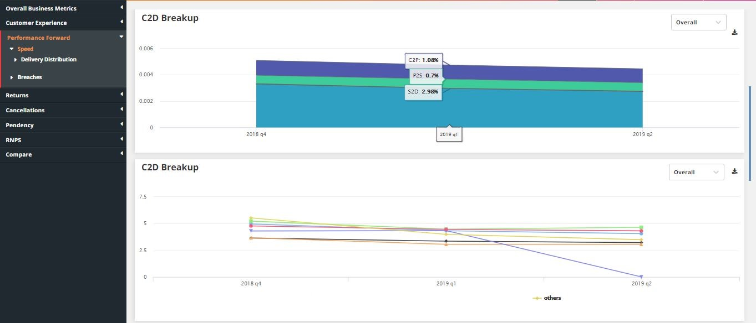
Control Tower – Measuring Performance Forward

Slide 31
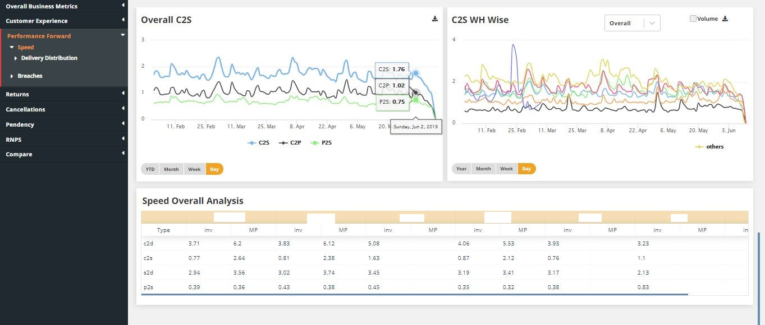
Control Tower – Measuring Performance Forward

Slide 32
Our Work with AstraZeneca

Slide 33
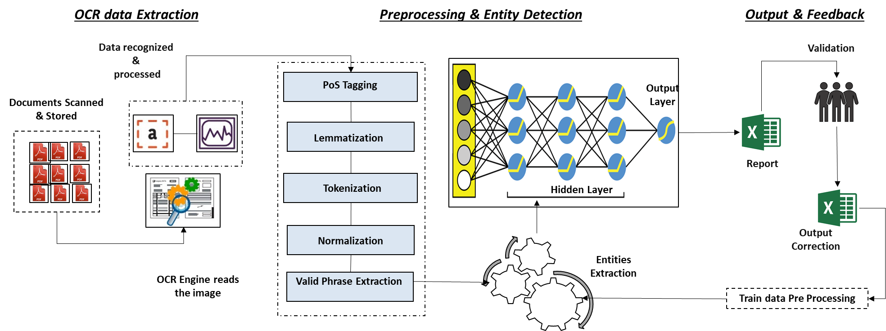
Using AI To Extract Actionable Insights From Documents
Leading Pharmaceutical and biopharmaceutical Company in UK
The Problem: Engagement with vendors across the globe has made review of contracts highly time consuming & labor intensive thereby leading to increased expenses associated with review , maintenance and administration of contracts on day-to-day basis.
The “Before” State
LatentView Solution
The “After” State
Business users are required to first search & identify required documents from two different source systems. And post identification, manually read through & extract required information from contracts for any review or analysis.
Developed a comprehensive view of contracts by automatically extracting & highlighting key provisions that are important to business users using industry-leading machine learning and natural language processing technology(NLP)
Automated solution for entity extraction has helped in reducing the time & cost by ~10 times.
Inbuilt exception module enabled users to validate any risks or erroneous data on priority.
Model Enrichment through automated feedback mechanism ensured model is continuously trained even by non technical users.
LatentView Solution workflow

Slide 34
AI Driven Solution
3 step approach for building the solution
Pattern Matching
NLP
Combination of “Regex + Fuzzy Logic” for checking & locating specific entities
Entities are completely detected using NLP models
Pattern Matching + NLP
“Pattern Matching” & “NLP” models used side by side for detecting entities

Slide 35
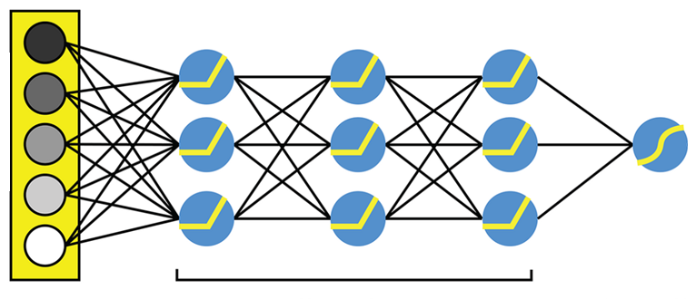





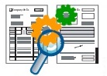
3 Stages of Solution Workflow
Data recognized &
processed
Validation
PoS Tagging
Output
Layer
Documents Scanned & Stored
Lemmatization
Report
Tokenization
Hidden Layer
Normalization
Output
Correction
Entities
Extraction
OCR Engine reads the image
Valid Phrase Extraction
Train data Pre Processing
OCR data Extraction
Preprocessing & Entity Detection
Output & Feedback
Conversion of input files to txt format. Current solution can handle following document formats
Selectable pdf & OCR based pdf
doc/doc
png/jpg/tiff
Data cleaning & standardization to ensure clean data is fed into the Deep learning model for entity detection.
This ensures unnecessary noise is reduced in the output
Excel report is generated with answers for all business queries
Post user validation the data is automatically processed and fed back into model

Slide 36
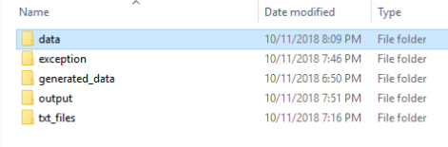
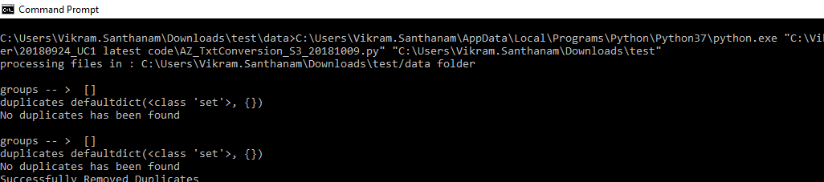
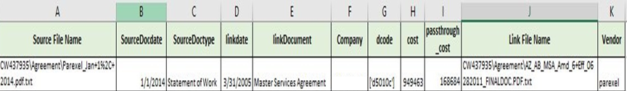
Tool Snapshot-Overall
Data loading
Code Execution
Output

Slide 37
Thank You

